Slide 1


Lending Club Case Study
SHIVANI KASHYAP

Slide 2
Problem Statement
ABSTRACT :
The given "Loan Dataset" contains information, about past loan urban applicants. Analyze the Loan Dataset (2007-2011) to identify patterns of the applicants, indicating potential loan defaults or not. Thereby helping the bank mitigate financial losses by taking various significant actions.
AIM :
Identification of such applicants using EDA is the aim of this case study.
BENEFITS OF THE CASE STUDY:
Gives a idea about how EDA is used in real life business problems.
It also develops a basic understanding of risk analytics in banking and financial services.
How the data is used to minimize the credit loss for the bank, while lending it to the customers.
It improves our understating of visualization and use of relevant charts to visualize the insights from the dataset.

Slide 3
Problem solving methodology
Data Analysis
Data Analysis
Data Analysis
Data Cleaning and Data Manipulation
Data Understanding
Univariate Analysis
Segmented Univariate Analysis
Analysing the continuous data columns with respect to the categorical column
Bivariate Analysis
Derived Metrics
Recommendations
Derived metrics are calculated from existing data in your dataset. They can provide deeper insights into your data and reveal relationships that are not immediately obvious.
Analysing all plots and recommendations for reducing the loss of business by detecting columns best which contribute to loan defaulters.
Removing the missing values from columns, unnecessary variables and checking the null value percentage and removing the respective rows.
Working with the Data Dictionary and getting knowledge of all the columns and their domain speciﬁc uses.
1. Outlier Detection,
2. Analyzing each column, plotting the distributions of single column.
Analysing the two variable behaviour like term and loan status with respect to loan amount.

Slide 4
Domain Understanding
Assume you work for a consumer finance company, which specializes in lending various types of loans to urban customers.
When the company receives a loan application, the company has to make a decision for loan approval based on the applicant’s profile.
Borrowers can easily access lower interest rate loans through a fast online interface. Like most other lending companies, lending loans to ‘risky’ applicants, is the largest source of financial loss (called credit loss).
Credit loss is the amount of money lost by the lender, when the borrower refuses, to pay or runs away, with the money owed.
In other words, borrowers who default, cause the largest amount of loss to the lenders. In this case, the customers labelled as 'charged-off' are the 'defaulters

Slide 5
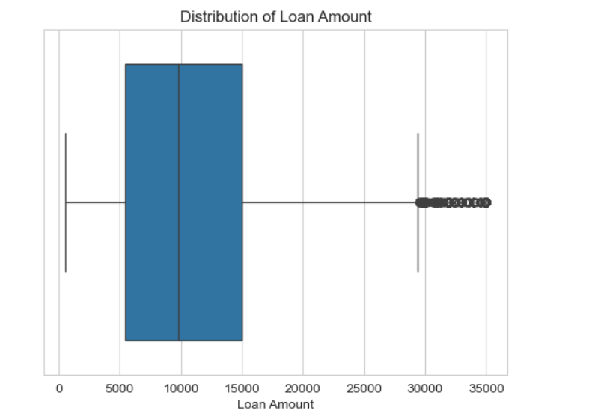
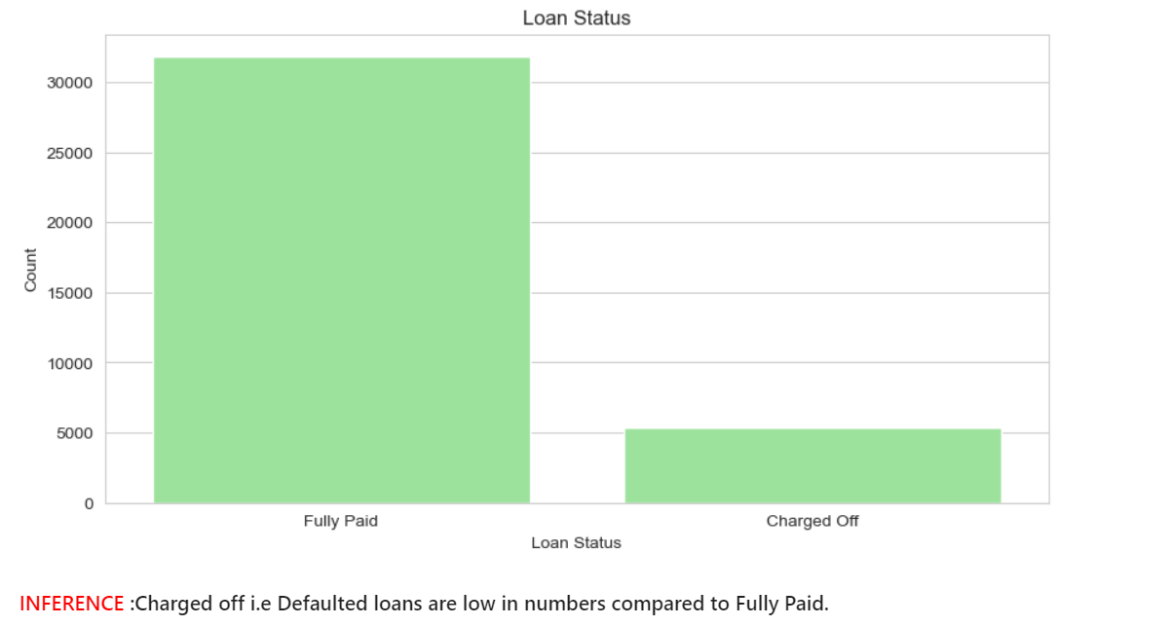
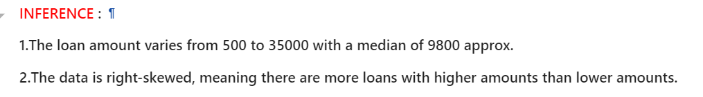
Univariate Analysis
Visualizing Distribution of Categorical Data.

Slide 6
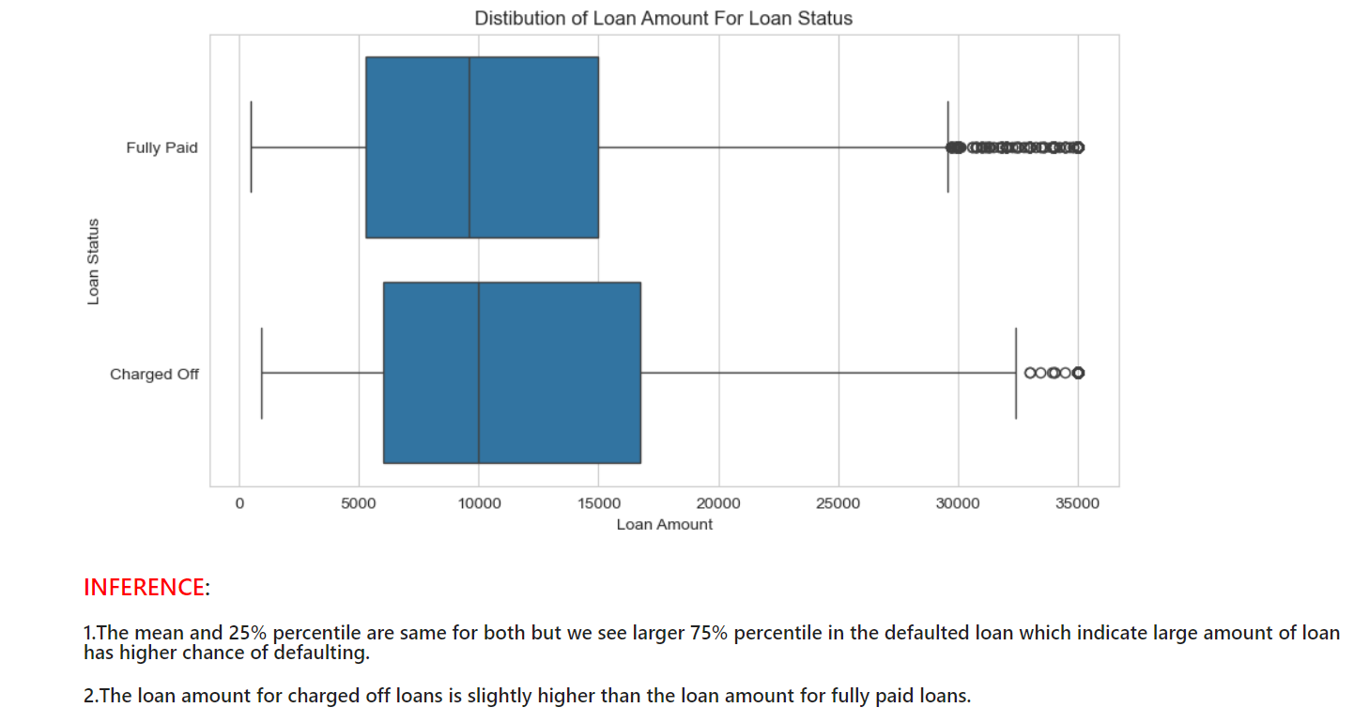
Univariate Analysis
Loan Amount And Loan Status

Slide 7
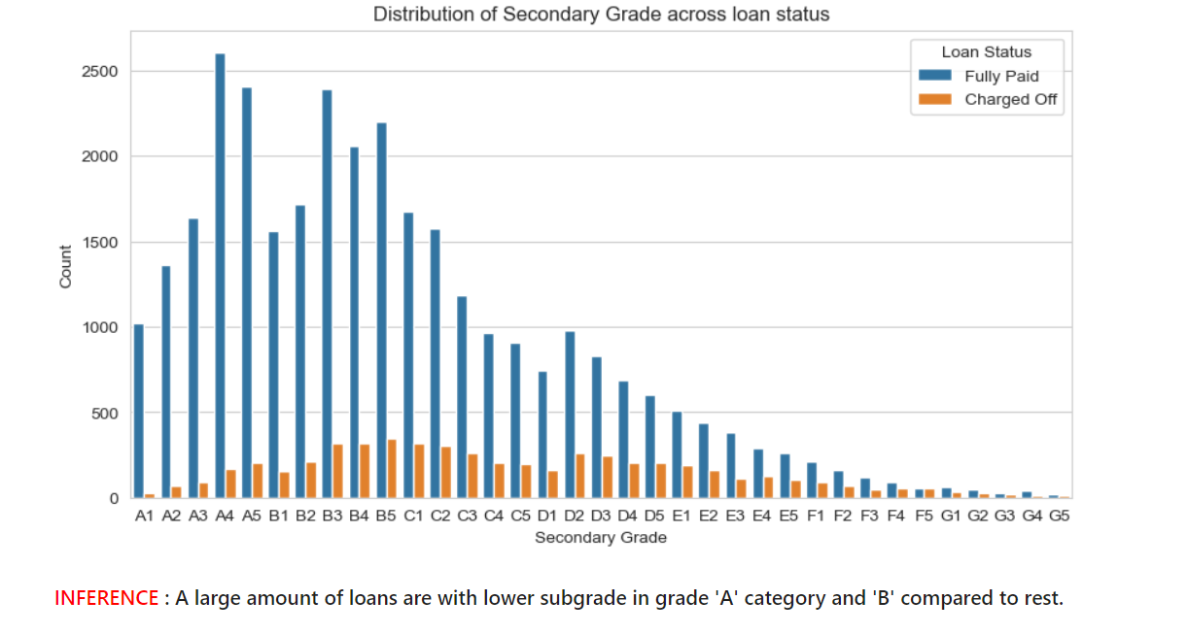
Univariate Analysis
Visualizing Distribution of Categorical Data.

Slide 8
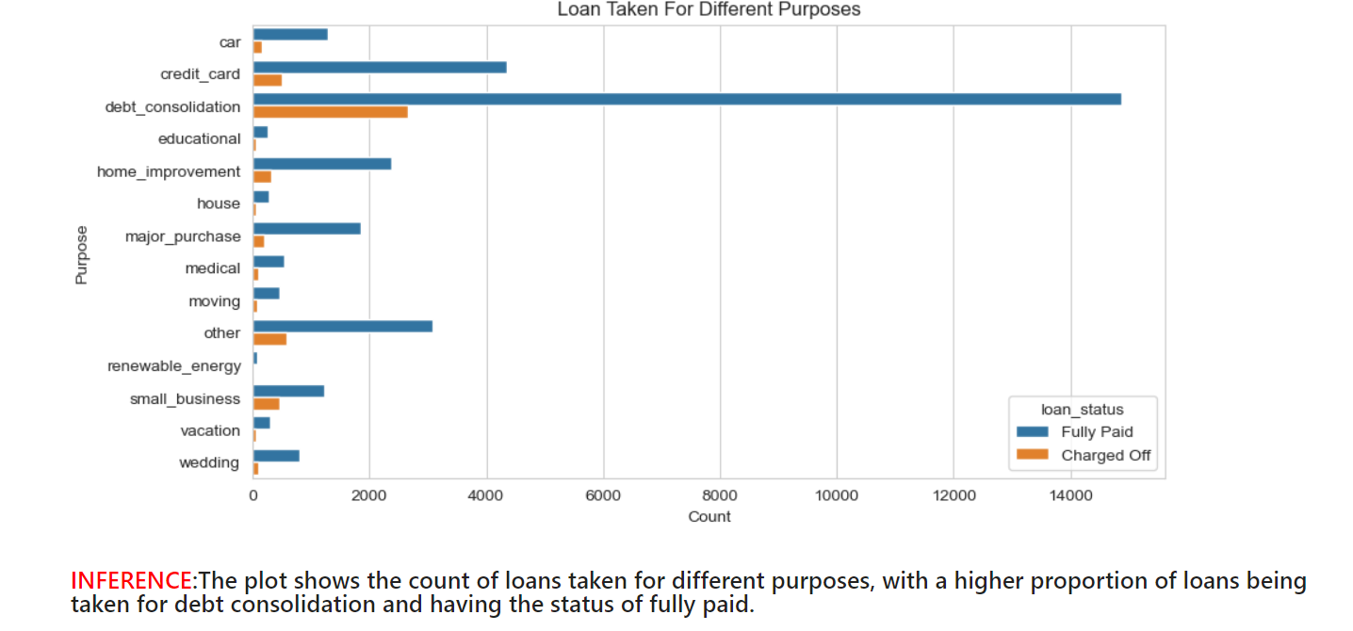
Segmented Univariate Analysis
Distribution of purpose based on loan_status

Slide 9
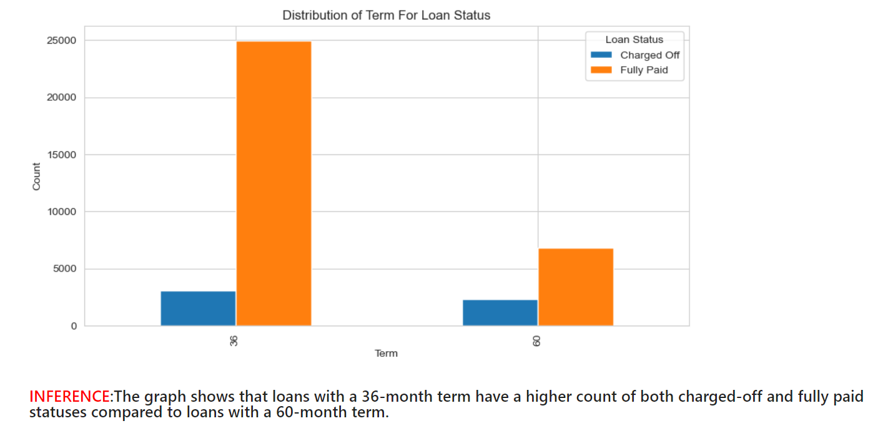
Segmented Univariate Analysis
Distribution of Term based on loan_status

Slide 10
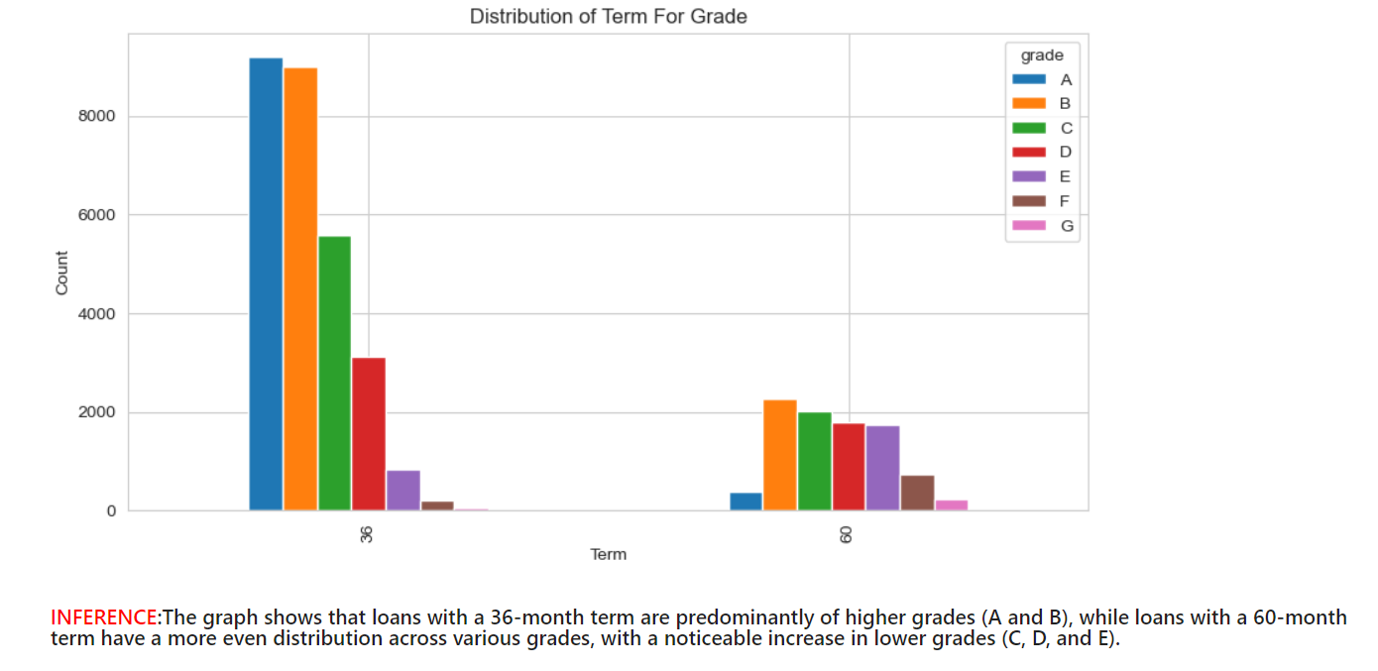
Segmented Univariate Analysis
Distribution of Term based on Grade

Slide 11
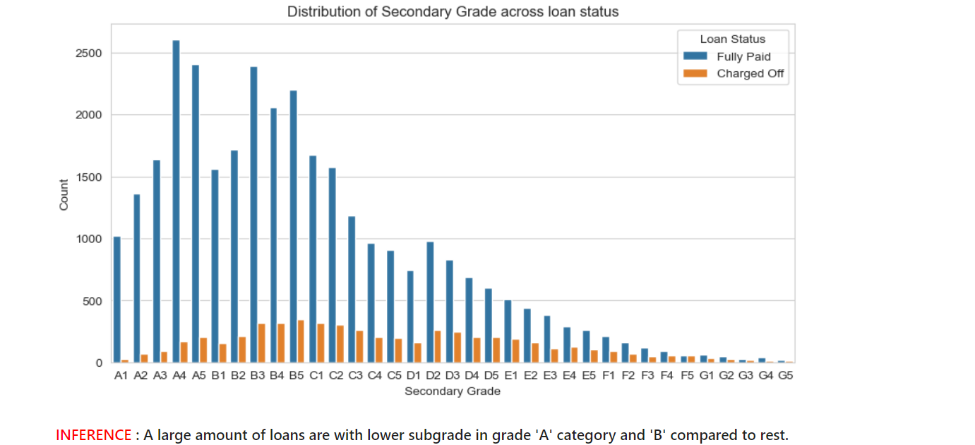
Grade and Sub-Grade

Slide 12
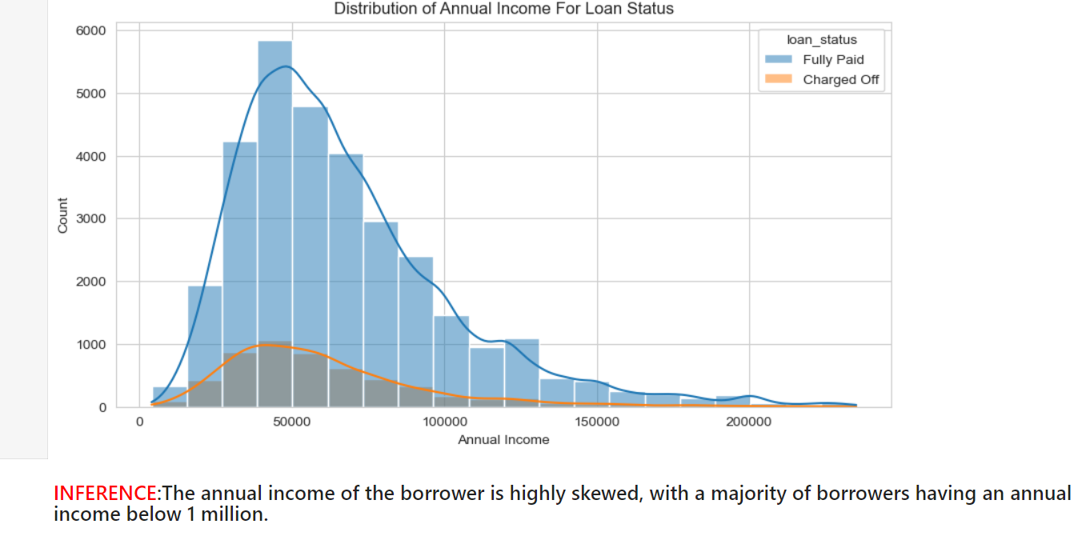
Annual Income And Purpose

Slide 13
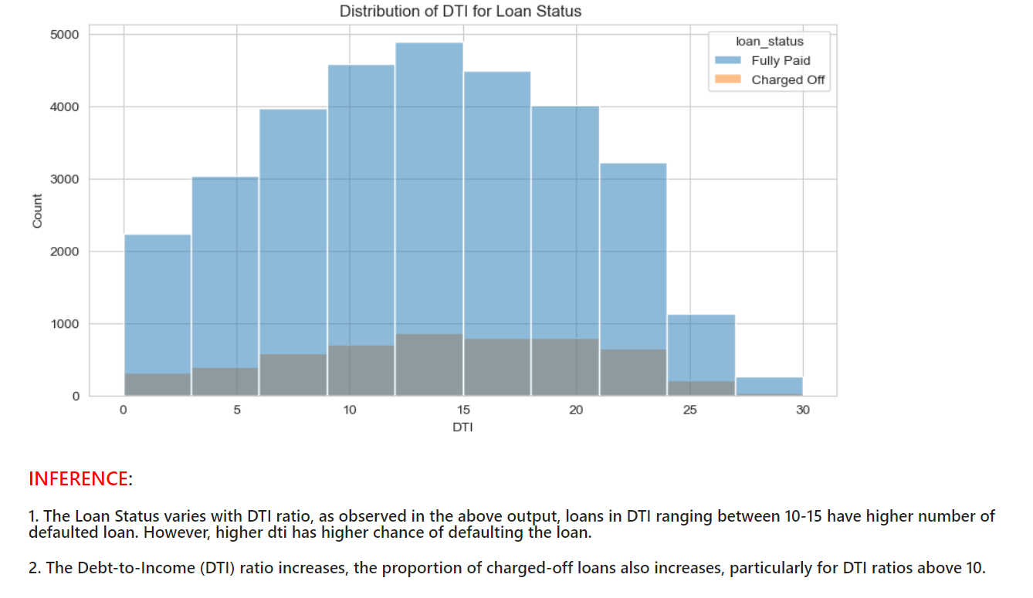
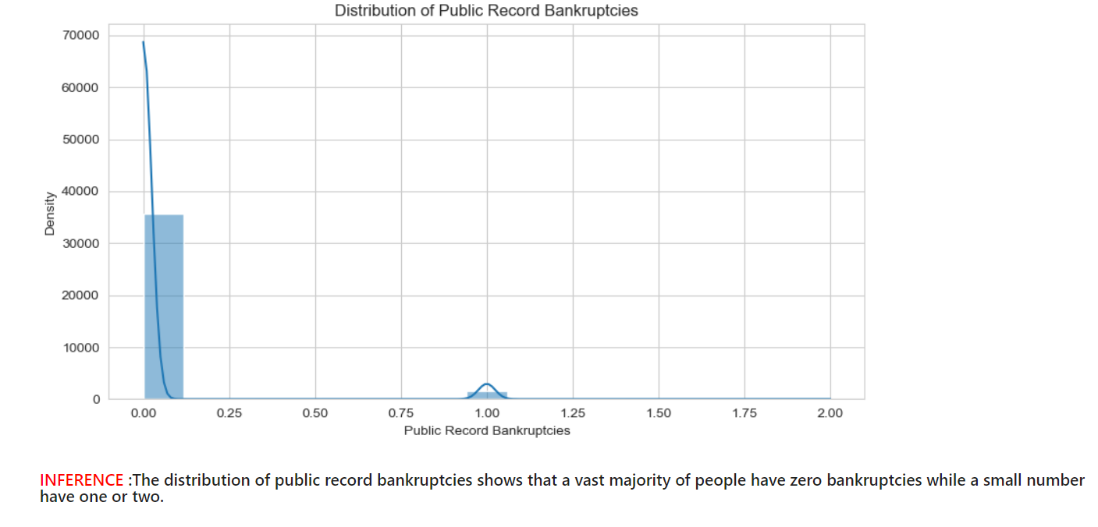
DTI Ratio and Bankruptcy

Slide 14
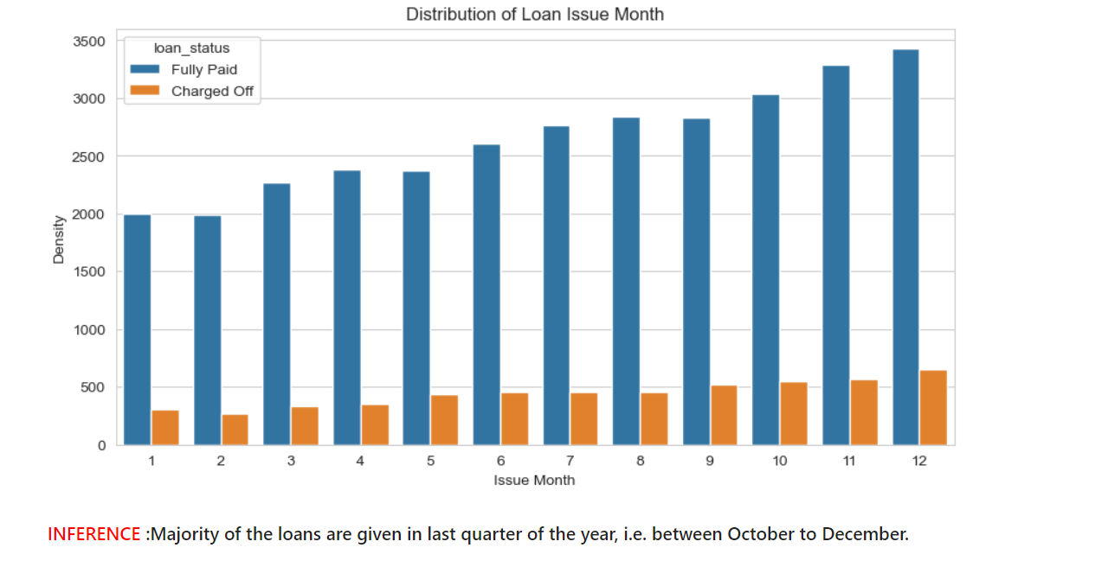
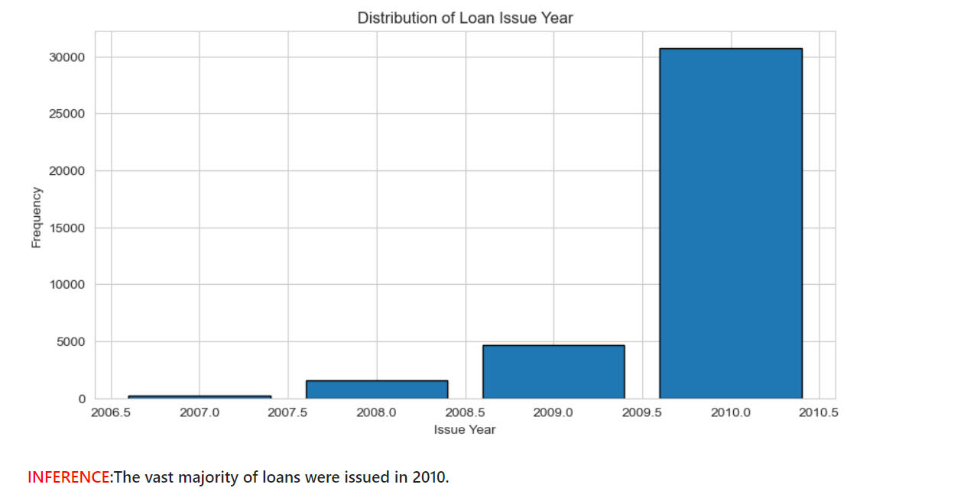
Loan Trend over years

Slide 15
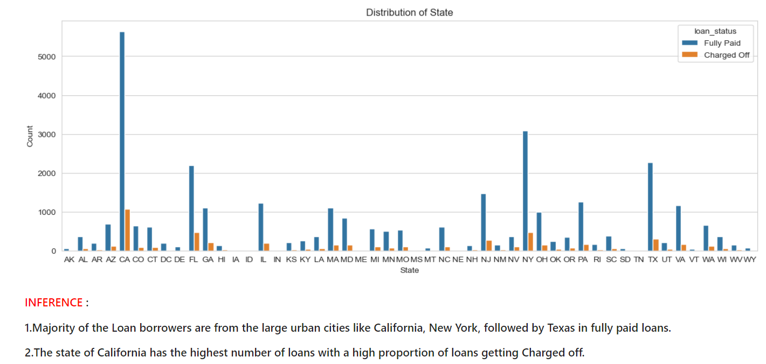
Segmented Univariate Analysis
State-wise distribution

Slide 16
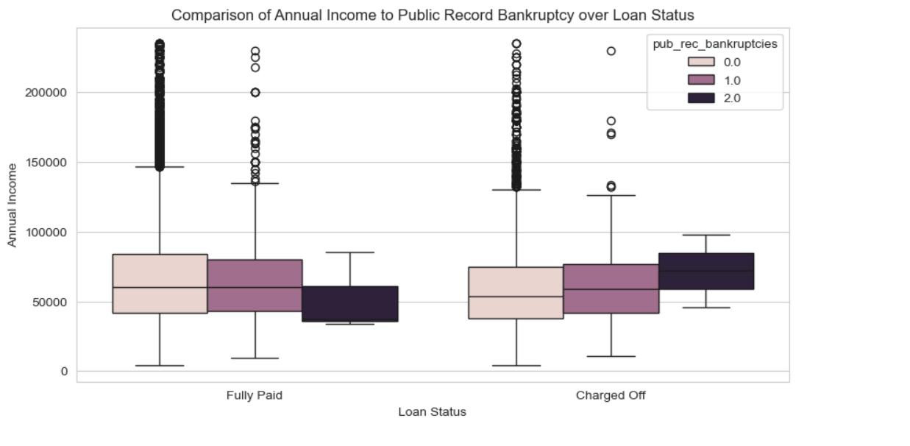
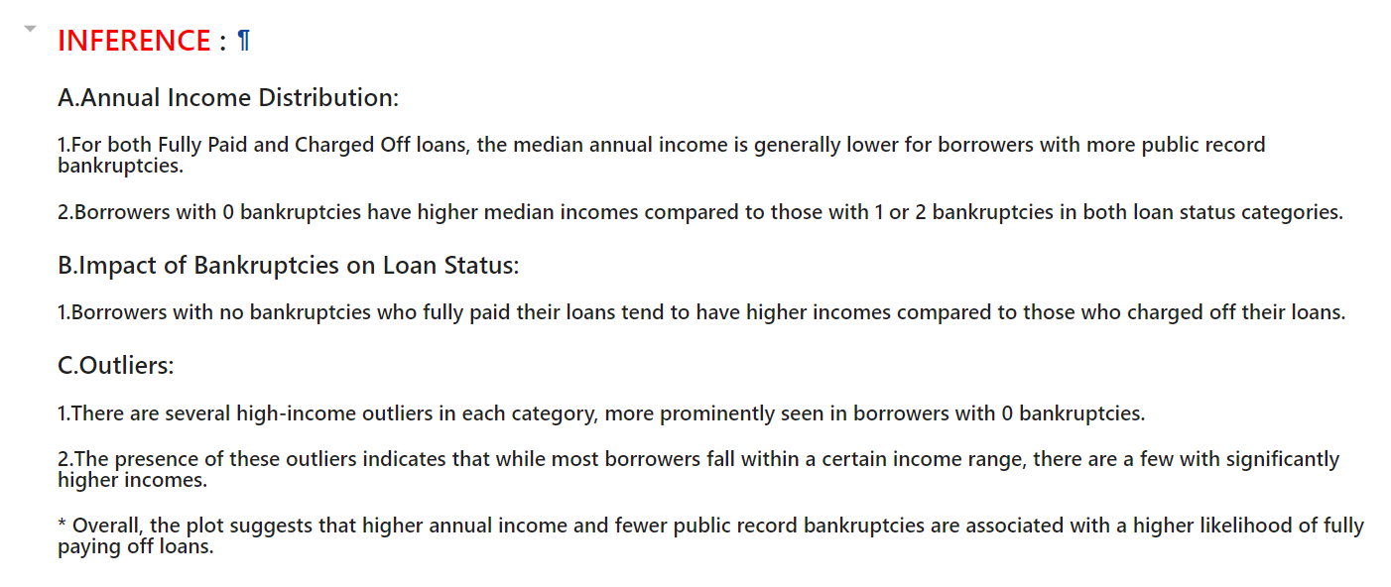
Bivariate Analysis

Slide 17
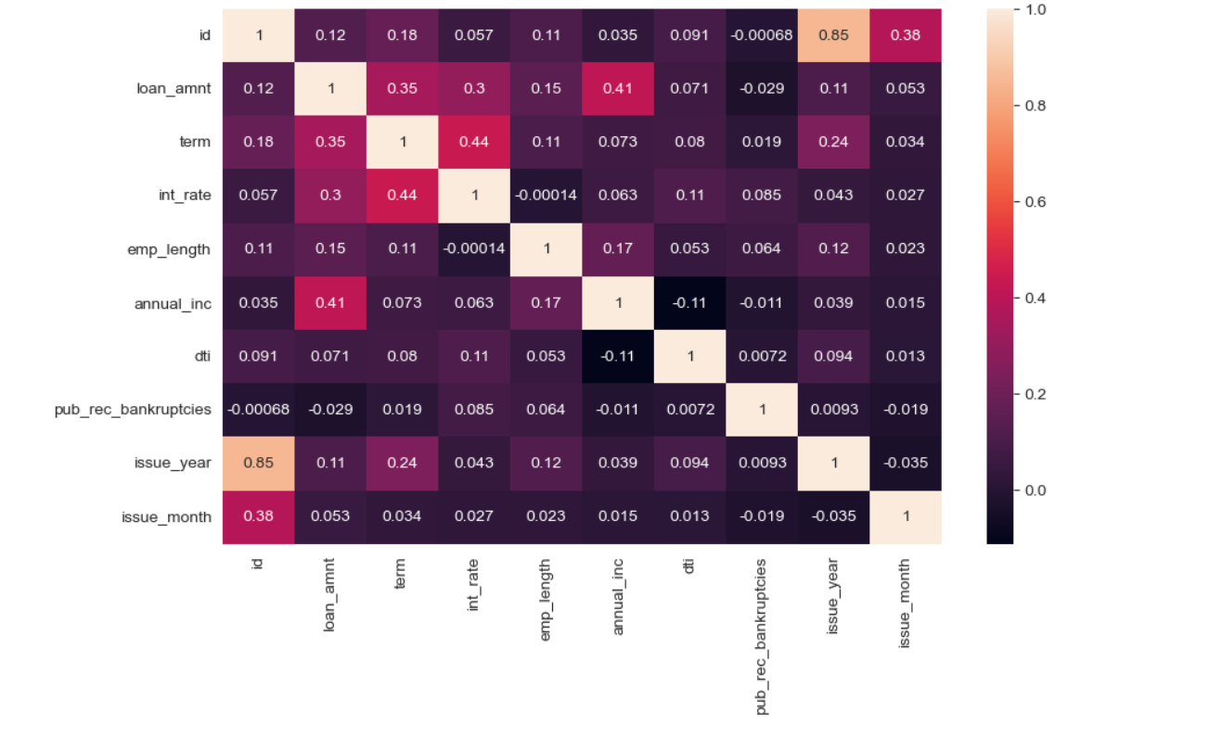
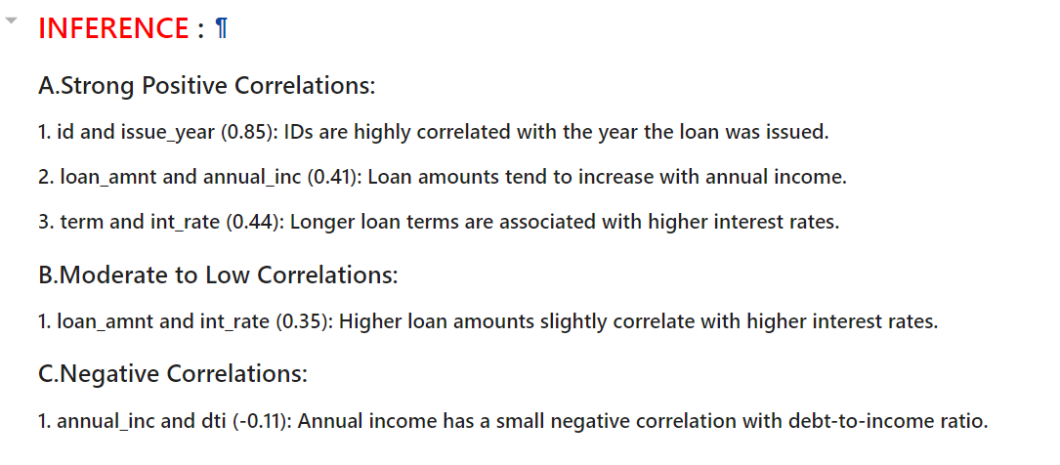
Bivariate Analysis

Slide 18
Insights
Univariate Analysis
Please refer to the 'Inferences' captured under Univariate Analysis.
Segmented Univariate Analysis
Please refer to the 'Inferences' captured under Segmented Univariate Analysis.
Derived Metrics Analysis
Please refer to the 'Derived Metrics Analysis' segment in the jupyter notebook.
Bivariate Analysis
1.The Grade represents the Risk factor, therefore we can say interest rate increases with the risk.
2.The borrowers are mostly having no record of Public Recorded Bankruptcy and are safe choice for loan.
Recommendations
Major Driving factor which can be used to predict the chance of defaulting loans and avoiding Credit Loss:
DTI
Loan Amount
Interest Rate
Grades
Annual income
Pub_rec_bankruptcies
Verification_Status

Slide 19
THANK YOU

